Slide 1
Kecerdasan Komputasional
Kelas F

Slide 2
Agenda
Review of previous lectures
Intro to ANN
Single layer perceptron
Multi layer perceptron
Back propagation learning algorithm
Summary

Slide 3
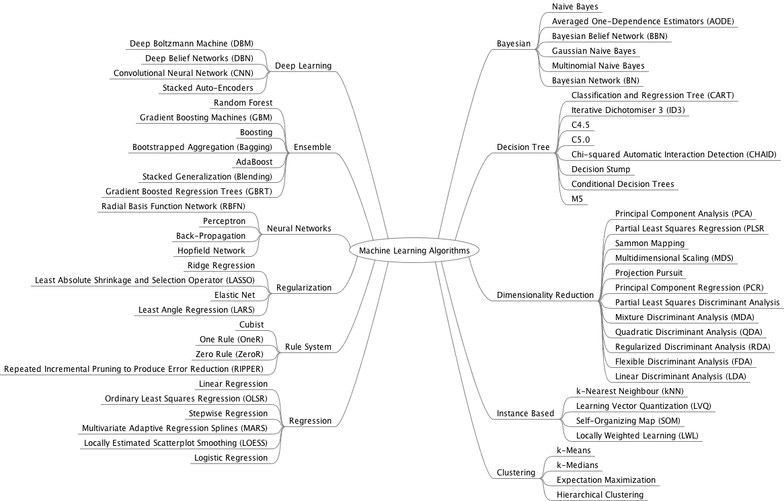
Mindmap By:
Dr. Jason Brownlee
2
4
1
5
3
Fuzzy Systems
6
Genetic Algorithms

Slide 4
Intro to ANN

Slide 5
Classes of Applications applying ANN
Classification: predict the class of an input vector
Pattern matching: produce a pattern best associated with a given input vector
Pattern completion: complete the missing parts of a given input vector
Optimization: find the optimal values of parameters in an optimization problem
Control: given an input vector, an appropriate action is suggested
Function approximation/times series modeling: learn the functional relationships between input and desired output vectors
Data mining: discover hidden patterns from data – also referred to as knowledge discovery

Slide 6
Neural Networks (NNs)
A realization of a nonlinear mapping from the dimension of the input space to that of target (desired output) space.
The mapping is usually a set of nonlinear functions, one for each neuron in the network.
Neurons form the basic building blocks of NNs.
Single neuron is usually called Perceptron.

Slide 7
Artificial Neuron (AN) atau Neuron
An artificial neuron (AN), or neuron, implements a nonlinear mapping from input signals usually to [0, 1] or [−1, 1], depending on the activation function used.
Each input signal (z_{i}) is associated a weight (v_{i}), to strengthen or deplete the input signal.
The AN computes the net input signal, and uses an activation function f_{AN} to compute the output signal, o, given the net input.
The strength of the output signal is further influenced by a threshold value (θ), also referred to as the bias.

Slide 8
Calculating the Net Input Signal
The net input signal to an AN is usually computed as the weighted sum of all input signals
Artificial neurons that compute the net input signal as the weighted sum of input signals are referred to as summation units (SU).

Slide 9
Calculating the Net Input Signal
An alternative to compute the net input signal is to use product units (PU)
Product units allow higher-order combinations of inputs, having the advantage of increased information capacity.

Slide 10
Activation Functions
The function f_{AN} receives the net input signal and bias, and determines the output (or firing strength) of the neuron. This function is referred to as the activation function.

Slide 11
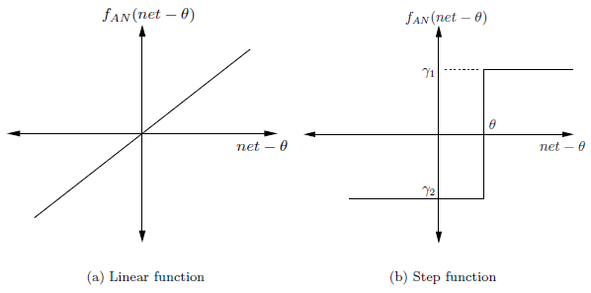
Activation Functions
Different types of activation functions can be used. Frequently used activation functions are:
Linear function
Step function
Ramp function
Sigmoid function
Hyperbolic function
Gaussian function

Slide 12
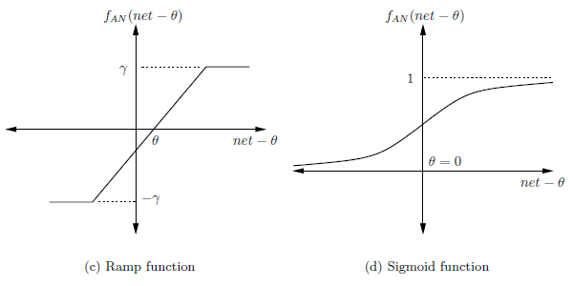
Activation Functions
Different types of activation functions can be used. Frequently used activation functions are:
Linear function
Step function
Ramp function
Sigmoid function
Hyperbolic function
Gaussian function

Slide 13
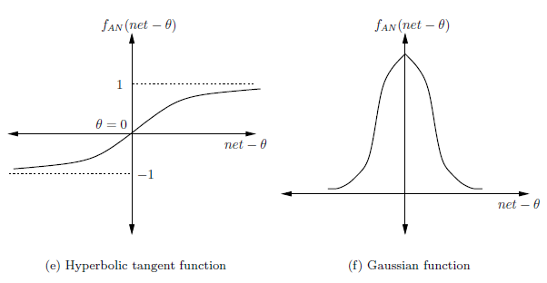
Activation Functions
Different types of activation functions can be used. Frequently used activation functions are:
Linear function
Step function
Ramp function
Sigmoid function
Hyperbolic function
Gaussian function

Slide 14
Linearly Separable Functions
Single neurons can be used to realize linearly separable functions without any error.
Linear separability means that the neuron can separate the space of I-dimensional input vectors yielding an above-threshold response from those having a below-threshold response by an I-dimensional hyperplane.
The hyperplane forms the boundary between the input vectors associated with the two output values.
Example: AND and OR Boolean functions can be implemented using a single perceptron. The two functions are linearly separable functions.

Slide 15
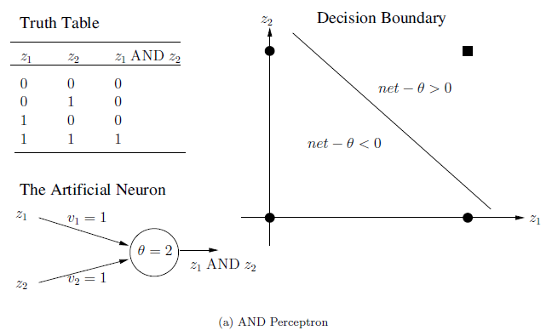
AND Perceptron

Slide 16
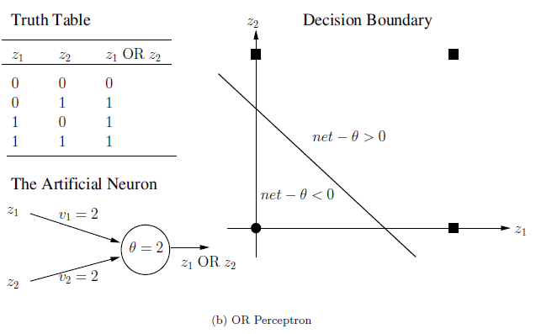
OR Perceptron

Slide 17
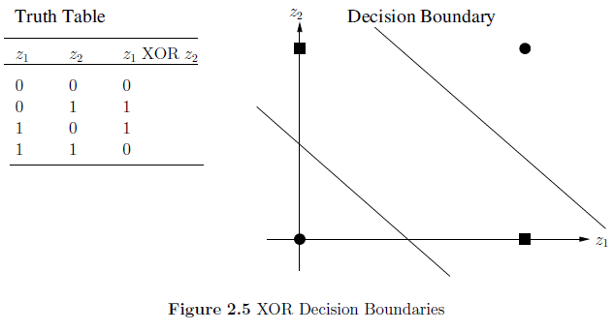
Non-linearly Separable Functions
An example of a Boolean function that is not linearly separable is the XOR.
A single perceptron can not implement this function.
If a single perceptron is used, then the best accuracy that can be obtained is 75%.
To be able to learn functions that are not linearly separable, a layered NN of several neurons is required.
For example, the XOR function requires two input units, two hidden units and one output unit.

Slide 18
Artificial Neuron Learning
Suppose that no prior knowledge exists about the function – except for data – how can the v_{i} and θ values be computed?
The answer is through learning.
The AN learns the best values for the v_{i} and θ from the given data.
Learning consists of adjusting weight and threshold values until a certain criterion (or several criterias) is (are) satisfied.

Slide 19
Artificial Neuron Learning
Three main types of learning:
Supervised
The neuron is provided with a data set consisting of input vectors and a target (desired output) associated with each input vector.
Aim: adjust the weight values such that the error between the real output of the neuron and the target output is minimized.
Unsupervised
Aim: discover patterns or features in the input data with no assistance from an external source. Many algorithms perform a clustering of the training patterns.
Reinforcement
Aim: reward the neuron for good performance, and penalize the neuron for bad performance.

Slide 20
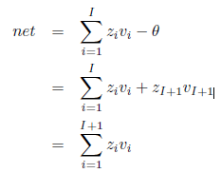
Augmented Vectors
Neuron is characterized by its weight vector v, threshold θ and activation function. During learning, both the weights and the threshold are adapted.
To simplify learning equations, the input vector is augmented to include an additional input unit, z_{I+1}, referred to as the bias unit.
The value of z_{I+1} is always -1, and the weight v_{I+1} serves as the value of the threshold.
The net input signal to the AN (assuming SUs)

Slide 21

Gradient Descent (GD) Learning Rule
GD requires the definition of an error (or objective) function to measure the neuron’s error in approximating the target, for example the sum of squared errors:
where t_{p} and o_{p} are the target and actual output for the p-th pattern,
and P_{T} is the total number of input-target vector pairs (patterns) in the training set.

Slide 22
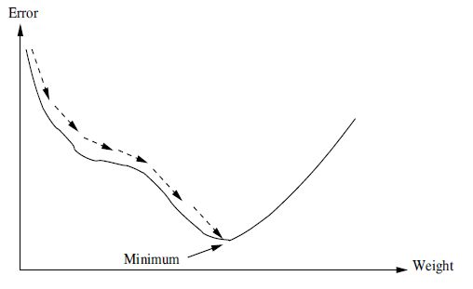
Gradient Descent (GD) Learning Rule
The aim of GD is to find the weight values that minimize Ɛ.
This is achieved by calculating the gradient of Ɛ in weight space, and to move the weight vector along the negative gradient.

Slide 23
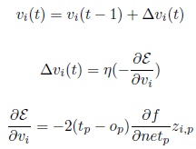
Gradient Descent (GD) Learning Rule
Given a single training pattern, weights are updated using:
with
where
and η is the learning rate: the size of the steps taken in the negative direction of the gradient.
The calculation of the partial derivative of f with respect to netp (the net input for pattern p) presents a problem for all discontinuous activation functions, such as the step and ramp functions; z_{i,p} is the i-th input signal corresponding to pattern p. The Widrow-Hoff learning rule presents a solution for the step and ramp functions, while the generalized delta learning rule assumes continuous functions that are at least once differentiable.

Slide 24



Widrow-Hoff Learning Rule
Assume that f = net_{p}. Then,
Weights are then updated using:
The Widrow-Hoff learning rule, also referred to as the least-means-square (LMS) algorithm, was one of the first algorithms used to train layered neural networks with multiple adaptive linear neurons. This network was commonly referred to as the Madaline.

Slide 25

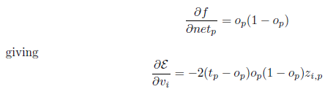
Generalized Delta Learning Rule
It assumes differentiable activation functions, for example the sigmoid function, then:

Slide 26
Error-Correction Learning Rule
It assumes that binary-valued activation functions are used, for example, the step function.
Weights are only adjusted when the neuron responds in error. That is, only when (t_{p} − o_{p}) = 1 or (t_{p} − o_{p}) = −1, are weights adjusted using equation:

Slide 27
Exercise 1
Is the following Boolean function can be realized with a single neuron that implements a SU? Justify your answer by giving weight and threshold values.
z₁z₂z₃’
where z₁z₂ denotes (z₁ AND z₂); z₁’ denotes (NOT z₁)

Slide 28
Exercise 2
Is the following Boolean function can be realized with a single neuron that implements a SU? Justify your answer by giving weight and threshold values.
z₁z₂'+z₁’z₂
where z₁z₂ denotes (z₁ AND z₂); z₁’ denotes (NOT z₁);
z₁ + z₂ denotes (z₁ OR z₂).

Slide 29
Answer
Is the following Boolean function can be realized with a single neuron that implements a SU? Justify your answer by giving weight and threshold values.
z₁z₂z₃’
where z₁z₂ denotes (z₁ AND z₂); z₁’ denotes (NOT z₁)
Answer: Yes.
Weight values: 1, 1, -1
Threshold value: 2

Slide 30
Exercise 2
Is the following Boolean function can be realized with a single neuron that implements a SU? Justify your answer by giving weight and threshold values.
z₁z₂'+z₁’z₂
where z₁z₂ denotes (z₁ AND z₂); z₁’ denotes (NOT z₁);
z₁ + z₂ denotes (z₁ OR z₂).
Answer: Yes.
Weight values: 1, -1
Threshold value: 1

Slide 31
Multilayer Neural Networks
Supervised Learning

Slide 32
Introduction
Types of multilayer neural networks:
Feedforward NNs
Recurrent NNs
Time-delay NNs
Feedforward NNs receive external signals and simply propagate these signals through all the layers to obtain the result (output) of the NN. There are no feedback connections to previous layers.
Recurrent NNs have feedback connections to model the temporal characteristics of the problem being learned.
Time-delay NNs memorize a window of previously observed patterns.

Slide 33
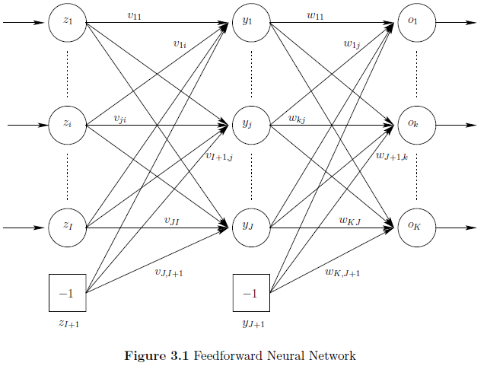
Feedforward NNs (FFNN)

Slide 34
Feedforward NNs (FFNN)
There are 3 layers:
An input layer
A hidden layer
An output layer
FFNN can have more than one hidden layer
FFNNs with monotonically increasing differentiable functions can approximate any continuous function with one hidden layer, provided that the hidden layer has enough hidden neurons.
A FFNN can also have direct (linear) connections between the input layer and the output layer.

Slide 35
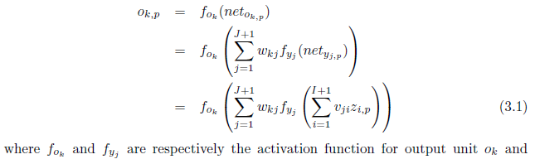

FFNN
The output of a FFNN for any given input pattern z_{p} is calculated with a single forward pass through the network. For each output unit o_{k}, we have (assuming no direct connections between the input and output layers),

Slide 36
The Supervised Learning Problem
NN Learning aims to minimize an objective function by an optimization method.
Several optimization algorithms for training NNs have been developed, which are grouped into two classes:
Local optimization: Gradient Descent, Scaled Conjugate Gradient
Global optimization: LeapFrog, simulated annealing, evolutionary algorithms, swarm optimization
Local and global optimization techniques can be combined to form hybrid training algorithms.

Slide 37
The Supervised Learning Problem
Learning consists of adjusting weights until an acceptable empirical error has been reached.
Two types of supervised learning algorithms exist, based on when weights are updated:
Stochastic/online learning: weights are updated after each pattern presentation.
Batch/offline learning: weight changes are accumulated and used to adjust weights only after all training patterns have been presented.

Slide 38
Gradient Descent Optimization (GDO)
This has led to one of the most popular learning algorithms, namely backpropagation, popularized by Werbos.
Learning iterations (epoch) consists of two phases:
Feedforward pass, which calculates the output values for each training pattern
Backward propagation, which propagates an error signal back from the output layer toward the input layer. Weights are adjusted as functions of the back-propagated error signal.

Slide 39

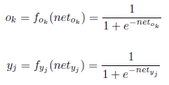
GDO in FFNN
Assume that the sum squared error (SSE) is used as the objective function. Then, for each pattern, z_{p},
where K is the number of output units, and t_{k,p} and o_{k,p} are the target and actual output values of the k-th output unit.
Assume sigmoid activation functions in the hidden and output layers with augmented vectors. All hidden and output units use SUs. Then,

Slide 40

GDO in FFNN
Weights are updated, in the case of stochastic learning, according to the following equations:
How to compute ∆w_{kj}(t) and ∆v_{ji}(t)?

Slide 41



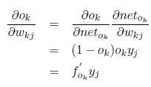


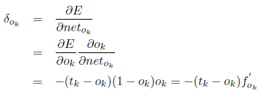
Assume sigmoid activation functions in the hidden and output layers with augmented vectors.
Assume that the sum squared error (SSE) is used as the objective function.
Define the output error that needs to be back-propagated as

Slide 42
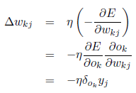
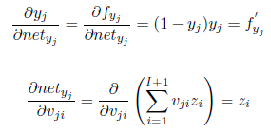
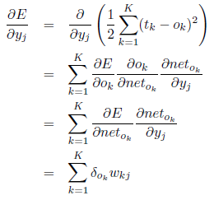
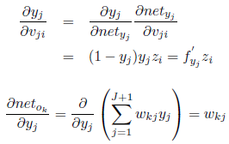
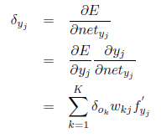
Then, the changes in the hidden-to-output weights are computed:
Continuing with the input-to-hidden weights,
Define the hidden layer error, which needs to be back-propagated:

Slide 43
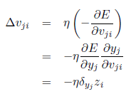
Finally, the changes to input-to-hidden weights are calculated:

Slide 44
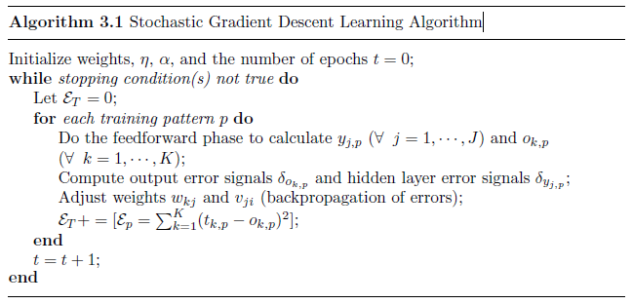
Stochastic Gradient Descent Learning Algorithm

Slide 45
Stopping Criteria
Stop when a maximum number of epochs has been exceeded.
Stop when the mean squared error (MSE) on the training set is small enough (other error measures such as the root mean squared error can also be used).
Stop when overfitting is observed, i.e. when training data is being memorized.

Slide 46
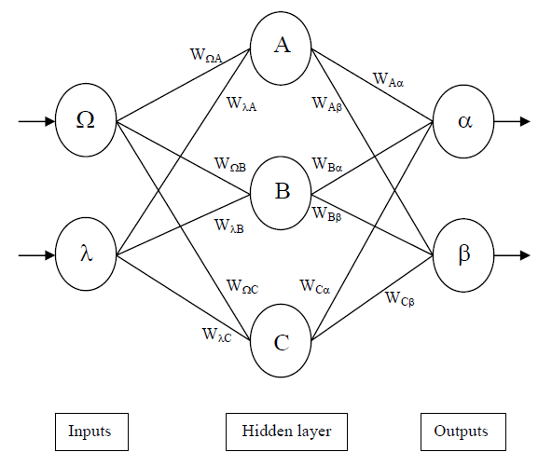
An Example

Slide 47
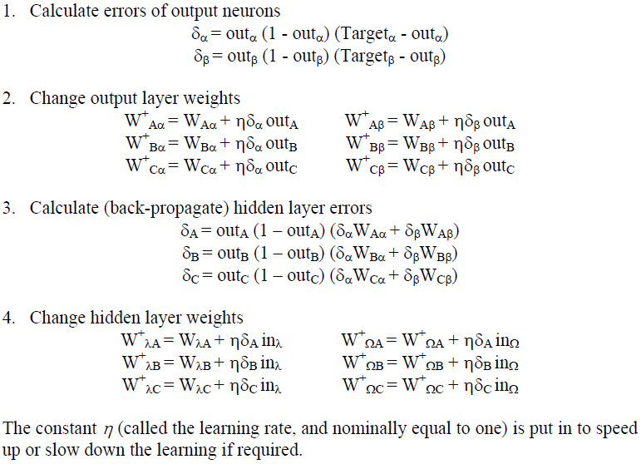
An Example

Slide 48
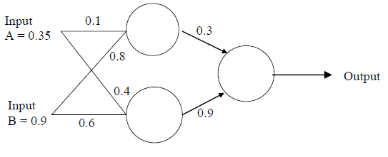
A Sample Exercise
Assume that the neurons have a Sigmoid activation function and
Perform a forward pass on the network.
Perform a reverse pass (training) once (target = 0.5).
Perform a further forward pass and comment on the result.

Slide 49

A Sample Answer
Perform a forward pass on the network.
Input to top neuron = (0.35x0.1)+(0.9x0.8)=0.755. Out = f(0.755) = 0.68.
Input to bottom neuron = (0.9x0.6)+(0.35x0.4) = 0.68. Out = 0.6637.
Input to final neuron = (0.3x0.68)+(0.9x0.6637) = 0.80133. Out = 0.69.

Slide 50
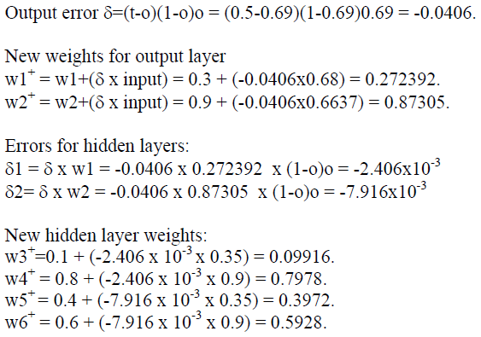
A Sample Answer
Perform a reverse pass (training) once (target = 0.5).

Slide 51
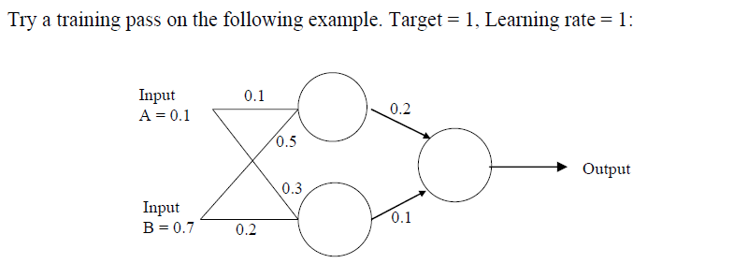
Exercise 1

